Slide 1
Global Finance Transformation Financial Reporting
Financial Reporting Concepts

Slide 2
Learning objectives
By the end of this module, you will be able to:
State the benefits of the new global Financial Reporting process
Identify the Financial Reporting dimensions within the FR tool
Explain the differences between the FR dimensions and P&B dimensions
Describe attributes of the new standard Financial Reports as well P&B reports in FR

Slide 3
Topics
1.
Introduction to GFT
2.
Objective of the Reporting Platform
3.
Approach to Standardization
4.
Financial Reporting Concepts
5.
Report Parameter Overview

Slide 4
Vision and Key Changes
Vision
Our goal is to create a world class global finance function that provides consistent high quality service to business managers and our client account teams, lowers enterprise risk and cost, supports improved integration of the organization globally and invests in development and career path for our people.
Key changes
a) Accounting Policies
b) One Global Reporting System
c) Standardized Reports
and Delivery
Policies will improve the comparability between our financial statements and drive standardization.
Policies will harmonize the overall layout of reports (e.g. revised P&L structured) and the definitions of our KPIs
Reduces local flexibility and individuality
Individual hierarchies and aggregations of code blocks reduced to one Management hierarchy managed by each Sub-Area
Common and consistent KPI definition
Changes and enhancements are managed by a governance process owned by Global Finance
Reports have a consistent layout as well as look-and-feel
Reports look different than currently and might have a different layout (e.g. order to columns)
Reports are mainly accessed via the new Reporting Portal (self-service) through the intranet and not sent out via email (some exceptions – report books)
Benefits
Globally consistent, standardized and comparable information based on a consistent set of KPIs/metrics, calculations and structures
A consistent tool set that supports mobility of people and quick information availability
Increased efficiency and reduced costs to run and maintain one central reporting system vs. many

Slide 5
Topics
1.
Introduction to GFT
2.
Objective of the Reporting Platform
3.
Approach to Standardization
4.
Financial Reporting Concepts
5.
Report Parameter Overview

Slide 6
Actuals available in Financial Reporting at the code block level
EY Organization
Global
Area
Region
Locally defined structures to support local management needs
Planning & Budgeting Unit*
Code block
Global
Area
Region
Locally defined structures to
support local management
Needs
Planning & Budgeting Unit*
Code block
Business Management
Finance
Business Management ~ 4,000 – 5,000 user | Finance ~ 1,200 user
High level report set with limited drill down functionality Reporting limited to level of Planning & Budgeting Unit, which holds Actual and Plan information (some access can be granted at code block level upon request) Access to the applicable high level data, relevant to understanding overall business performance and drive business decisions Certain reports will be made available to Business Management below the Planning & Budgeting unit showing only Actual vs. PY | More detailed reports with ability to go below Planning & Budgeting Unit level where only Actuals are captured Ability to drill down from operations statement lines into the GL accounts within a single view Ad Hoc access to base data for a limited set of ad hoc users only
*Planning & Budgeting Unit is the lowest level of detail used for both financial planning and associated management reporting

Slide 7
Topics
1.
Introduction to GFT
2.
Objective of the Reporting Platform
3.
Approach to Standardization
4.
Financial Reporting Concepts
5.
Report Parameter Overview

Slide 8
Approach to Standardization for Financial Reporting
The Reporting solution will be a combination of global standardization and local flexibility
Design component | Globally standard | Local flexibility | Comments
Report Templates/Formats and Layouts | 4 |  | Pre-defined report layouts/formats to be used as part of standard reporting
Report Delivery | 4 |  | Standard method is “pull” Only certain reports will be “pushed” Defined consistently globally
Metrics, KPIs and Accounting Policies | 4 |  | Defined globally and an agreed set will be shown on the reports
Management Hierarchies: Global – Area – Sub-Area Reporting Structure below Sub-Area | 4 | 4 | Standard/consistent view above the Sub-Area level Local flexibility allowed below this level (from Sub-Area down to code-block)
Currency | 4 |  | Support of Global, Area, Alternate Area and Local currency
Service Line Structure | 4 |  | Service Line roll up defined globally

Slide 9
Standard Reporting vs. Ad hoc Analysis
In addition to standard reports available in the reporting portal, a subset of users will be able to conduct ad hoc analysis using Excel
Standard Reporting
Access via the Reporting portal through the Intranet
Standardized and consistent report templates
Limited access to reports, data and functionality
Functionality of reports differ for Finance and Business Management users
Standard delivery methodology: pull
For Business Management certain reports will be pushed
Ad Hoc Analysis
Access through Microsoft Excel only for a limited number of Finance people
Free-form analysis - no templates available but limited to the existing data models
Use of Excel’s analysis functionality:
Standard functionality like sorting, grouping, calculations
Graphical functionality
Pivoting functionality
Delivery methodology to other audiences: individual push (no automation)

Slide 10
Topics
1.
Introduction to GFT
2.
Objective of the Reporting Platform
3.
Approach to Standardization
4.
Financial Reporting Concepts
5.
Report Parameter Overview

Slide 11
New Financial Reporting Concepts
A
Currency Conversion
Report Variances
Total Variance
Operational Variance
Exchange Rate Variance
B
Weekly & Monthly Data Updates
C

Slide 12
A. Currency Conversion Overview
Transactions are captured in local currency in GFIS. For management reporting purposes, those local currency results get converted into agreed upon currencies to report on cross country results:
Area Currency (defined by each Area) Area - Constant
Alternate Area Currency (EMEIA only) Alternate Area - Constant (EMEIA only)
Global Currency Global - Constant
Area | Local | Area | Alternate Area | Global
Americas | Various | USD | - | USD
EMEIA | Various | EUR | GBP | USD
Asia-Pacific | Various | AUD | - | USD
Japan | YEN | YEN | - | USD

Slide 13
A. Currency Conversion P&L and Balance Sheet
Profit & Loss accounts
 | For regular weeks (all but last week of the month) data is converted using the weekly average rate received on Friday For the last week of the month (daily data updates) the prior week’s rate is used (new exchange rate not available yet) and then reconverted on the weekend with the week’s rate (like during regular weeks) Data of day +1 to +3 is converted with the rate from prior Friday Monthly P&L data represents aggregation of the weekly converted data
month 1 week 1
week 2
week 3
week 4
week 5
month 2 week 1
week 2
week 3
week 4
month 3 week 1
0.27225177
0.27225487
0.27223808
0.27225645
0.27234561
0.27231342
0.27278102
0.27312013
0.27310198
0.27289123
Balance Sheet accounts
 | Balance Sheet positions are translated using the exchange rate in effect on the last day of the respective reporting period
month 1 week 1
week 2
week 3
week 4
week 5
month 2 week 1
week 2
week 3
week 4
month 3 week 1
0.27225177
0.27225487
0.27223808
0.27225645
0.27234561
0.27231342
0.27278102
0.27312013
0.27310198
0.27289123

Slide 14

A. Currency Conversion Adjustment during parallel run
Currency conversion in GFT_FR is applied on a weekly basis (consistent with Engagement Reporting) for weekly and monthly reporting.
GFIS_FR converts today on a monthly basis.
To ensure consistency during the 6-months parallel run an adjustment to capture this conversion difference will be applied to GFT_FR.
✓
✓
✗
GFT_FR
weekly
=
GFT_FR
monthly
=
GFIS_FR
monthly
=
GFIS_FR
weekly
based on GL data
based on GL data
based on GL data
based on ER data
TNR
 | EUR | x rate | USD
week 1 | 100 | 1.3100 | 131.00
week 2 | 120 | 1.3300 | 159.60
week 3 | 110 | 1.2900 | 141.90
week 4 | 130 | 1.3000 | 169.00
memo: week 1-4 | 460 | 1.3076 | 601.50
adj week | 10 | 1.3025 | 13.03
total month | 470 | 1.3075 | 614.53
EUR | x rate | USD
100 | 1.3100 | 131.00
120 | 1.3300 | 159.60
110 | 1.2900 | 141.90
140 | 1.3002 | 182.03
470 | 1.3075 | 614.53
EUR | x rate | USD
470 | 1.3075 | 614.53

Slide 15
B. Report Variances Total Variance
Total Variance is based on variable rates.
Total Variance = Operational Variance + Exchange Rate Variance
Total Variance | Variance Calculation
Variance in absolute amount: | Actual at Current Rate - Plan at Constant Rate*
 | Actual at Current Rate – PY at PY Rate
Variance in %: | (Actual at Current Rate - Plan at Plan Rate) / Plan at Constant Rate*
 | (Actual at Current Rate - PY at PY Rate) / PY at PY Rate
* Constant Rate = Plan Rate
Example: Total Variance vs Plan
Actual | Actual at Plan Rate | Plan | Total Variance
 |  |  | inc/(dec) vs Plan | inc/(dec) % vs Plan
1,200 | 1,275 | 1,300 | (100) | (7.7%)
a | b | c | d=a-c | =d/c
Example: Total Variance vs Prior Year
Actual | Actual at Plan Rate | PY | PY at Plan Rate | Total Variance
 |  |  |  | inc/(dec) vs PY | inc/(dec) % vs PY
1,200 | 1,275 | 1,100 | 1,000 | 100 | 9.1%
a | b | d | e | f=a-d | =f/d

Slide 16
B. Report Variances Operational Variance
Operational Variances compare scenarios based on constant rates and eliminate the effect of exchange rate fluctuations.
Operational Variance | Variance Calculation
Variance in absolute amount: | Actual at Constant Rate* – Plan at Constant Rate*
 | Actual at Constant Rate* – PY at Constant Rate*
Variance in %: | (Actual at Constant Rate* – Plan at Constant Rate*) / Plan at Constant Rate*
 | (Actual at Constant Rate* – PY at Constant Rate*) / PY at Constant Rate*
* Constant Rate = Plan Rate
Example: Operational Variance vs Plan
Actual | Actual at Plan Rate | Plan | Operational Variance
 |  |  | inc/(dec) vs Plan | inc/(dec) % vs Plan
1,200 | 1,275 | 1,300 | (25) | (1.9%)
A | B | C | d=b-c | =d/c
Example: Operational Variance vs Prior Year
Actual | Actual at Plan Rate | PY | PY at Plan Rate | Operational Variance
 |  |  |  | inc/(dec) vs PY | inc/(dec) % vs PY
1,200 | 1,275 | 1,100 | 1,000 | 275 | 27.5%
a | b | e | f | g=b-f | =g/f

Slide 17
B. Report Variances Exchange Rate Variance
Exchange Rate Variance is used to show the impact of exchange rate fluctuations
Exchange Rate Variance | Variance Calculation
Exchange Rate Variance: | Total Variance – Operational Variance
Variance in absolute amount: | (Actual at Current Rate - Actual at Constant Rate*)
 | (Actual at Current Rate - Actual at Constant Rate*) - ( PY at PY Rate - PY at Constant Rate*)
Variance in %: | (Actual at Current Rate - Actual at Constant Rate*) / Plan at Constant Rate*
 | (Actual at Current Rate / PY at PY Rate ) – ( Actual at Constant Rate* / PY at Constant Rate* )
Example: Exchange Rate Variance vs Plan
* Constant Rate = Plan Rate
Actual | Actual at Plan Rate | Plan | xRate Variance
 |  |  | inc/(dec) vs Plan | inc/(dec) % vs Plan
1,200 | 1,275 | 1,300 | (75) | (5.9%)
a | b | C | d=a-b | =d/c
Example: Exchange Rate Variance vs Prior Year
Actual | Actual at Plan Rate | PY | PY at Plan Rate | xRate Variance
 |  |  |  | inc/(dec) vs PY | inc/(dec) % vs PY
1,200 | 1,275 | 1,100 | 1,000 | (175) | (18.4%)
a | b | d | e | =(a-b)-(d-e) | =(a/d)-(b/e)

Slide 18
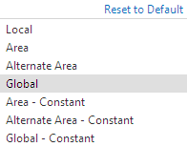
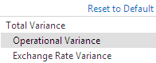
B. Report Variances Interaction between the Currency and Variance Filters (1/2)
The user has to fully understand the selections they are making in the currency and variance filter selections and how they interact in the reports
Depending on the combination of selections in the Currency and Variance filter dropdowns, variances that are calculated manually may not match with what is displayed in the variance column on the reports.
Currency
Variance
Total Variance is based on variable rates
Operational Variances compares scenarios based on constant rates and eliminate the effect of exchange rate fluctuations
Exchange Rate Variance is used to show the impact of exchange rate fluctuations
Drives the Actual Plan/ Outlook and PY data columns

Slide 19
B. Report Variances Interaction between the Currency and Variance Filters (2/2)
Depending on the drop down selection in the currency and variance filter, the user may not be able to manually calculate the variances displayed in the reports
1
Filter Selections - Global Constant Currency; Operational Variance
MTD |  |  |  | FY12 July
 |  | Operational Variances
Actual at Plan Rate | PY at Plan Rate | inc/(dec) vs PY | inc/(dec)% vs PY
1,304,540 | 1,434,714 | (130,174) | (9.1%) | Standard Engagement Revenue
Example 1: The variance is an exact calculation and can be manually calculated
2
Filter Selections - Global Currency; Total Variance
MTD |  |  |  | FY12 July
 |  | Total Variances
Actual | PY | inc/(dec) vs PY | inc/(dec)% vs PY
1,343,702 | 1,361,121 | (17,418) | (1.3%) | Standard Engagement Revenue
Example 2: The variance is an exact calculation and can be manually calculated
Filter Selections - Global Currency; Operational Variance
Example 3: The variance is excluding exchange rate fluctuations and cannot be manually calculated in this example.
Common to report results across multiple currencies using the Area or Global currency combined with the operational variance.
3
MTD |  |  |  | FY12 July
 |  | Operational Variances
Actual | PY | inc/(dec) vs PY | inc/(dec)% vs PY
1,343,702 | 1,361,121 | (130,174) | (9.1%) | Standard Engagement Revenue

Slide 20
B. Report Variances Weekly TNR variance
The weekly reports split out the TNR variance to Plan/Outlook/Prior Year into 3 different components.
TNR Variance | Pricing | Capacity/Resourcing | Productivity
Pricing
CY Charged Hrs * (CY TNR Rate/Hr – PY TNR Rate/Hr)
Resourcing
PY Charged Hrs/FTE * (CY FTE – PY FTE ) * PY TNR Rate/Hr
Productivity
CY FTE * (CY Charged Hrs/FTE - PY Charged Hrs/FTE) * PY TNR Rate/Hr
Where CY = current year and PY = prior year or plan

Slide 21
B. Report Variances Weekly Charged Hours variance
The weekly reports split out the Charged Hours variance to Plan/Outlook/ Prior Year into 2 different components.
Charged Hours Variance | Capacity/Resourcing | Productivity
Resourcing
PY Charged Hrs/FTE * (CY FTE – PY FTE )
Productivity
CY FTE * (CY Charged Hrs/FTE - PY Charged Hrs/FTE)
Where CY = current year and PY = prior year or plan

Slide 22
C. Weekly and Monthly Data Updates
GFIS GL
The status of the latest load is available on the Standard/Favorite Reports page
Weekly and monthly data updates
Close week GL entries
5-Week month
Weekly data will be updated over the weekend and available each Monday
Monthly data will be updated
Daily during the last week of the fiscal month (week 4 or 5)
Tuesday – Thursday during the week of the month end close ( showing data from day 1, 2, 3)
Adjustments in the weekly cube will be loaded with wk1 data of the following month
All data will be updated as early as possible (dependent on the availability of the data from GFIS)
After operation of the system has been transitioned to the Operating / BI group SLAs will be provided
Beginning of the month
End of the month
Final month-end results
weekly
data
monthly
data
GFIS GL
Daily updates
wk1
wk2
wk3
wk4
wk5
day1
day2
day3
Close week GL entries
4-Week month
Beginning of the month
End of the month
Final month-end results
weekly
data
monthly
data
Daily updates
wk1
wk2
wk3
wk4
day1
day2
day3

Slide 23
C. Weekly and Monthly Data Updates Data and Calculations (1/2)
FTE calculations: weekly vs. monthly data/cube
Weekly cube
Monthly cube
Weekly cube gets updated on a weekly basis
On the weekly cube you can select week 4 and look at the MTD number which are calculated as (week 1 + week 2 + week 3 + week 4) / 4
Monthly cube only on a monthly basis (with daily updates on the closing week)
Whereas the monthly cube doesn't have the week option available and therefore always calculates as (week 1 + week 2 + week 3 + week 4 + week 5) / 5 disregarding if any of those weeks are not available or not
So until we get the week 5 update the monthly cube will show the wrong FTE numbers as they are incomplete
Due to the daily updates during the last week of the month the Op Statement data is not complete and is not reasonable in many lines
Keep in mind:
Daily updates are made at month end to better support the close process and to ensure journal entries are posted correctly
At certain times different data/results will appear if comparing the weekly and monthly data. This is driven by the fact that the cubes are updated at different times.
Example:
Example 2nd day of week 5 (Tuesday): Weekly cube only has the data until Friday last week (week 4)
Whereas the monthly cube already shows the data as of the day before (Monday of week 5).

Slide 24
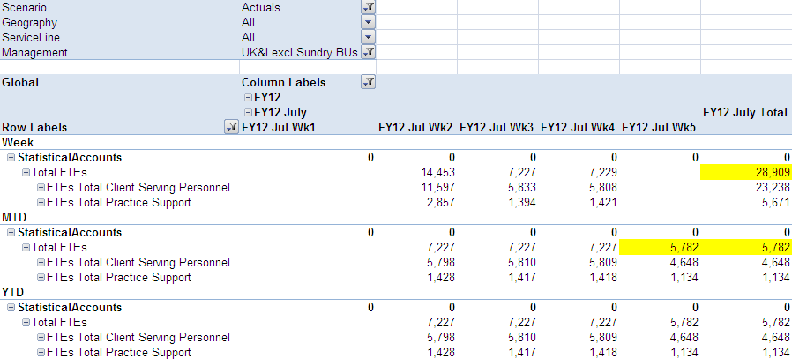
C. Weekly and Monthly Data Updates Data and Calculations (2/2)
Illustration
Illustration:
We are in the last week of a five week month
Daily updates are being processed during week five in the monthly cubes
Since the month is not complete the FTEs in the example will be calculated as:
(W1+W2+W3+W4+W5) / 5 → 28,909/5 = 5,782

Slide 25
Topics
1.
Introduction to GFT
2.
Objective of the Reporting Platform
3.
Approach to Standardization
4.
Financial Reporting Concepts
5.
Report Parameter Overview

Slide 26
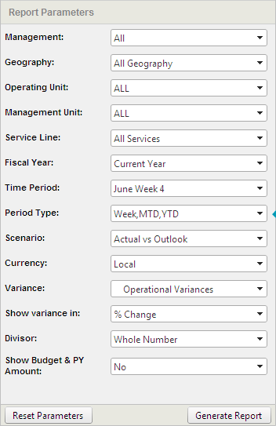
Financial Reporting Standard Report Parameters
Finance users will have access to the report parameters below and will be able to use the drop down menus to filter to specific cuts of data
Financial Reporting Standard Report Parameters
Parameter Drop Down Fields

Slide 27
FR Standard Report Parameters Organizational Hierarchy
Although the code block is the lowest level in the Management Dimension, each code block element can be queried separately using the dimensions below
Management | Geography | Operating Unit* | Management Unit* | Service Line | Markets
Global Area Sub-Area .. .. Planning Unit BU-OU-MU- SMU | All Areas Area Sub-Area GFIS Country Managerial Country Legal Entity Business Unit | OUxxx | MUxxx | Service Line Sub Service Line Groups Sub Service Lines SMU Groups SMUs | All Markets Developed markets Emerging markets FSO markets Other markets
*OU and MU report filters are available to the Finance community only

Slide 28
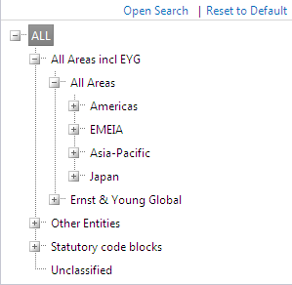
FR Standard Report Parameters Management
Management
Maintenance:
Globally defined (down to Sub-Area level)
Locally by Super Users (below Sub-Area level)
The Management dimension captures the way EY is organized and managed internally.
As part of release 1 & 2, we will only deliver one standard management hierarchy. Additional Alternate Management hierarchies could follow as a future enhancement.
Description
Example
Globally defined allowing local flexibility
Includes double counting for ‘Private Equity Joint Venture’
Lowest level: Code block (BU-OU-MU-SMU)
Audience:
Business Management
Finance

Slide 29
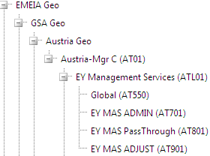
FR Standard Report Parameters Geography
Geography
Maintenance:
Globally defined
The Geography dimension captures the legal, external structure of EY.
This structure differs from the Management dimension because Sub-Areas in the Management dimension, such as FSO and EYG Services, are accounted for within the Countries in the Geography Dimension.
Description
Example
Globally maintained Geography hierarchy
Additional roll ups can be requested via the Super Users
Lowest level: BU
Audience:
Select Business Management roles
Finance

Slide 30
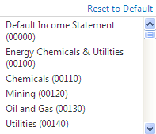
FR Standard Report Parameters Operating Unit
Operating Unit
Maintenance:
Globally defined
This dimension will consist of a flat list of all used Operating Units and will be available to Finance only on certain reports and via ad hoc
Description
Example
Filtering plan information using this dimension might provide skewed results
Additional roll ups can be requested via the Super Users
Lowest level: OUxxx
Audience:
Finance

Slide 31
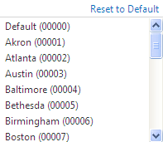
FR Standard Report Parameters Management Unit
Management Unit
Maintenance:
Globally defined
This dimension will consist of a flat list of all used Management Units and will be available to Finance only on certain reports and via ad hoc
Description
Example
Filtering plan information using this dimension might provide skewed results
Additional roll ups can be requested via the Super Users
Lowest level: MUxxx
Audience:
Finance

Slide 32
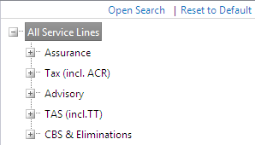
FR Standard Report Parameters Service Line
Service Line
Maintenance:
Globally defined
Globally defined structure capturing our Service and Sub Service Lines.
No local flexibility available to reflect a different Service Line roll up.
Description
Example
Globally consistent SL hierarchy
Includes double counting for ‘Transaction Tax’ in TAS and ‘Accounting Compliance & Reporting’ (ACR) in BTC
Lowest level: SMU
Audience:
Business Management
Finance

Slide 33
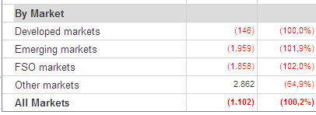
FR Standard Report Parameters Markets
new since release III
Markets
Maintenance:
Globally defined
Globally defined structure capturing our Markets structure
No local flexibility available to reflect a different Markets assignment.
Description
Example
Globally consistent assignment of Sub-Areas to markets
Lowest level: Markets itself (e.g. developed markets)
The Market dimension is only available in the ‘Executive Weekly Flash’ and ‘Executive Dashboard’ (as well as in Ad-Hoc) and not as an additional filter in other reports

Slide 34
Standard Report Parameters Interaction between Management, Geography & SL
The Management, Geography & Service Line dimensions interact with each other to achieve certain cuts of the data
Example | Management Filter Selection | Geography Filter Selection | Service Line Filter Selection
EMEIA including EYGS (Assurance) | All Areas including EYG | EMEIA Geo | Assurance
EMEIA excluding EYGS (Assurance) | EMEIA | All Geo | Assurance
FraLux excluding FSO (Advisory) | FraLux | All Geo | Advisory
FraLux incl FSO excl EYGS (Advisory) | EMEIA | FraLux Geo | Advisory
FraLux incl FSO incl EYGS (Advisory) | All Areas including EYG | FraLux Geo | Advisory
US including EYC & BBC (Tax) | US Based | Americas Geo | Tax
US excluding EYC & BBC (Tax) | US Based | US Geo | Tax
Australia + New Zealand including FSO excluding EYGS (TAS) | Asia Pacific | EYANZ | TAS

Slide 35
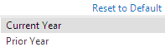
FR Standard Report Parameters Fiscal Year
Fiscal Year
Maintenance:
Globally defined
Contains the current year and 2 years of historical data
Prior Prior Year will be available on reports which do not show a comparison between two years as Prior Prior Prior Year is not available
Description
Example
Captures the fiscal year to which the data is linked
Audience:
Business Management
Finance
*In the FY12 reports, FY11 data has been restated to reflect the Foundational Elements policy changes.
The FY10 Actuals have not been restated in this respect and are therefore not comparable to the FY12 structure.

Slide 36
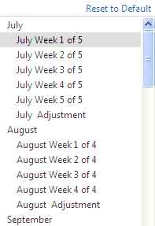
FR Standard Report Parameters Time Period
Time Period
Maintenance:
Globally defined
There will be a total of 53 weeks and Week will be based on the standard global calendar (5/4/4)
Description
Example
Regular time periods such as weeks and months
Weeks only available on weekly reports
Month 998 is used to capture GL adjustments for a given year without booking them to a particular month
Audience:
Business Management
Finance
The monthly Adjustment weeks are used to capture the currency conversion adjustment mentioned in the Concepts section

Slide 37
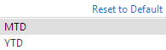
FR Standard Report Parameters Period Type
Period Type
Maintenance:
Globally defined
Allows user to swap between MTD and YTD views
Additional period types will be added as part of a future release
Description
Example
Audience:
Business Management
Finance

Slide 38
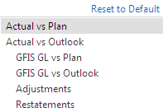
FR Standard Report Parameters Scenario*
new since release III
* P&B reports offer additional scenarios (see next page)
Scenario
Maintenance:
Globally defined
Allows the user to swap between various categories of data
Plan / Outlook data is only available in the Current Year
FY12 Reports will only capture the FY12 Plan Data
FY11 Reports will only capture the FY11 Plan / Outlook Data
Description
Example
Actual represents GFIS GL + Adjustments + Restatements
GFIS GL represents data as recorded in GFIS
Adjustments captures data for non GFIS countries and outside of GFIS adjustments
Restatements captures prior year restatements for accounting policy changes
Audience:
Finance

Slide 39
FR Standard Report Parameters Currency*
* P&B reports only contain constant rates
Currency
Maintenance:
Globally defined
Allows the user to swap between Local, Area, Alternate Area and Global currencies
Description
Example
Constant rates are used to calculate operational variances excluding exchange rate effects
Audience:
Business Management
Finance

Slide 40
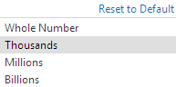
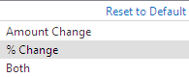
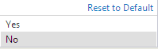
FR Standard Report Parameters Additional Drop Down Menus
There are additional report parameters which will be used to show specific cuts of data within the standard reports
Variance:
Operational Variance is the default variance, but Exchange Rate Variance and Total Variance will also be available to Finance.
Divisor:
This parameter serves to change the number display. The default will be defined as Thousands. This can be changed on the User Preferences screen.
Show Budget & PY Amount:
This allows the user to see the absolute amounts of the Budget & PY. Per default the absolute amounts will be hidden.
Show Variance In:
% Change is the default on most reports, and Finance user s can switch the display.

Slide 41
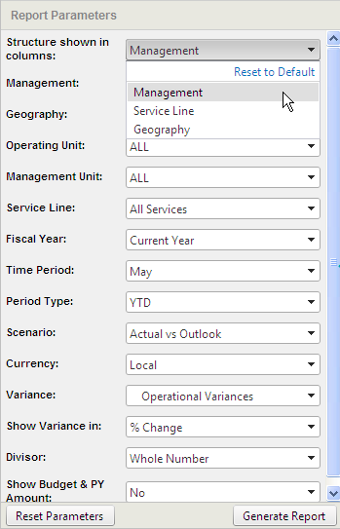
FR Standard Report Parameters Structure Shown In Columns (1/2)
Multi-organization reports will have an extra report parameter to allow users to select multiple organizations that they want to view in a report
Structure Shown in Columns:
Users are allowed to choose which structure/ organizations they would like to see across the top of some reports
Reports which have this filter allow users to use a multi-select feature in the Management, Geography, or Service Line parameters
Allow users to display multiple organizations across a report
Multi-Organization Reports have this parameter:
Detailed Executive Weekly Flash – Multi Organization
Operations Statement – Multi Organization
Summary Operations Statement – Multi Organization
Indirect Expense Report – Multi Organization

Slide 42
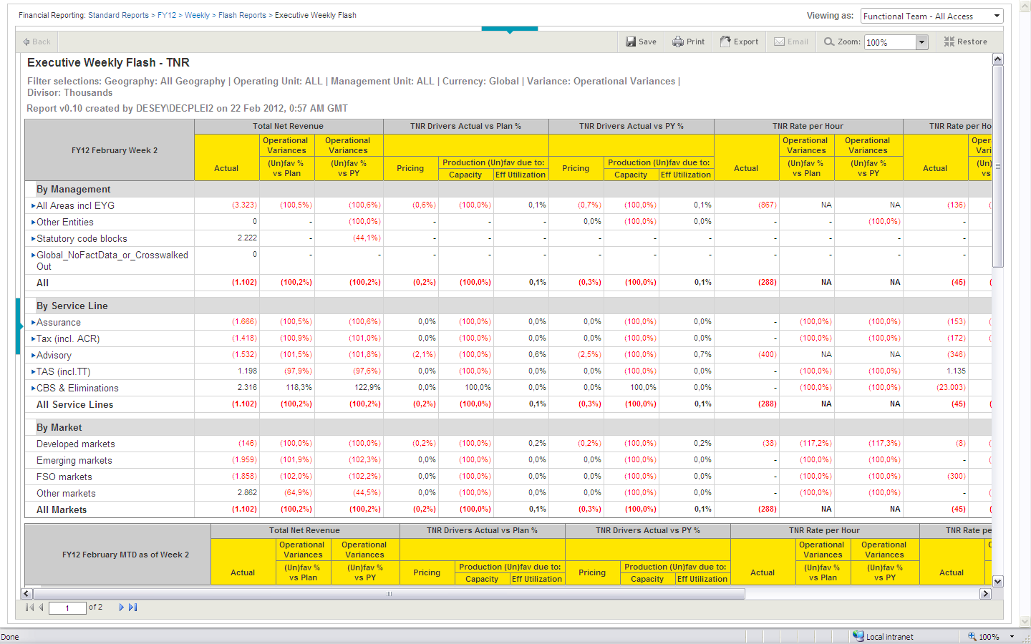
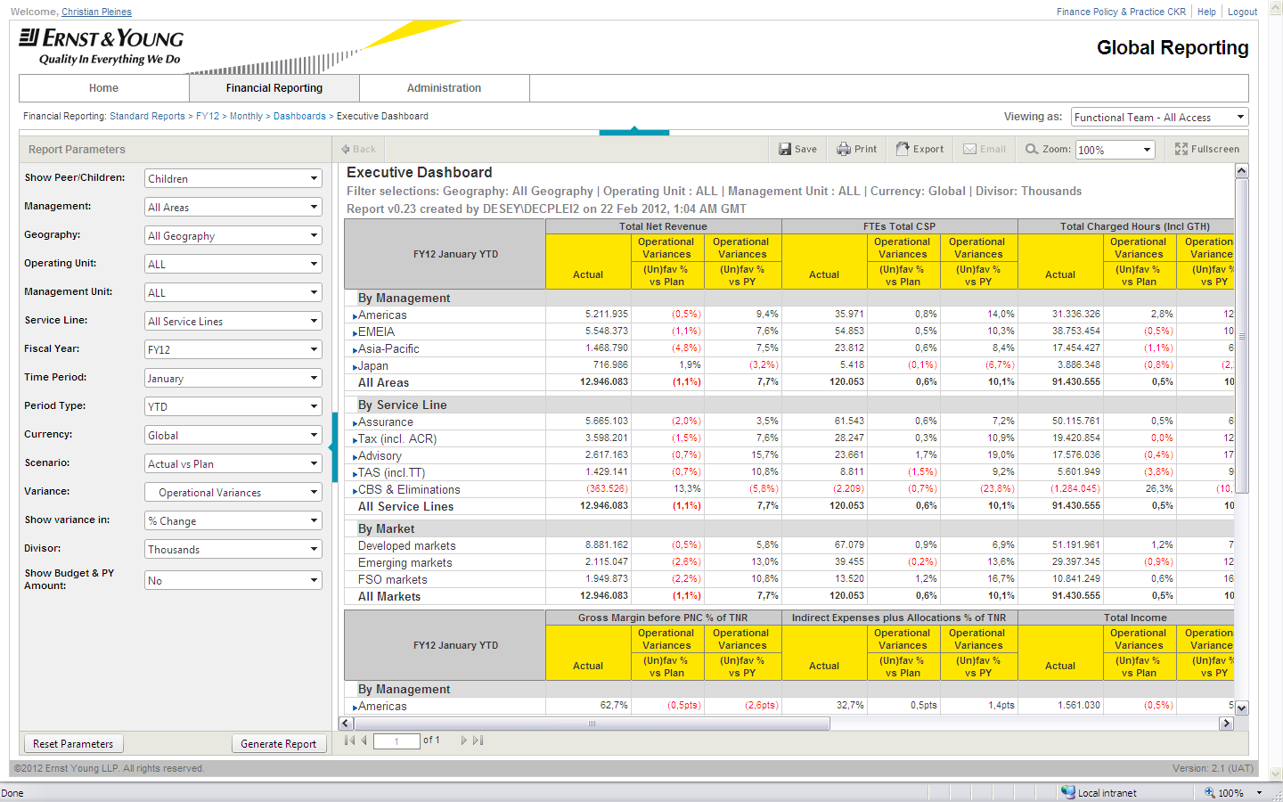
FR Standard Report Parameters Structure Shown In Columns (2/2)
new since release III
For the Executive Weekly Flash and the Executive Dashboard, the Management, Service Line and Markets dimensions dictate the content displayed on the report. The Geography dimension interacts with the other dimensions, but the Geography hierarchy is not displayed on the face of the reports.
Executive Weekly Flash
Executive Dashboard
Management:
The Management hierarchy will always appear in rows and the Geography parameter will only influence the data in these reports
Service Line:
The Service Line hierarchy will always appear in rows in these reports, regardless of specific parameter selections
Markets:
The Markets hierarchy will always appear in rows in these reports, regardless of specific parameter selections. There is no drill-down functionality in the dimension.

Slide 43
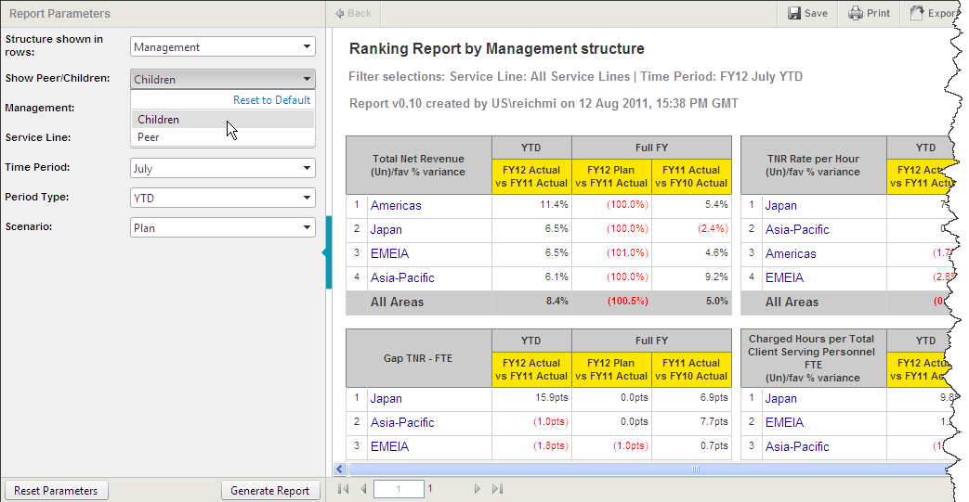
FR Standard Report Parameters Show Peer/Children
Users can utilize this parameter to compare peers/siblings or children members of a hierarchy within the report
Show Peer/Children:
Users can utilize this parameter to compare peer members of a hierarchy or children members of a hierarchy
This parameter allows for comparison across management organizations
Two Reports have this parameter:
Ranking Report by Peer
Executive Dashboard

Slide 44
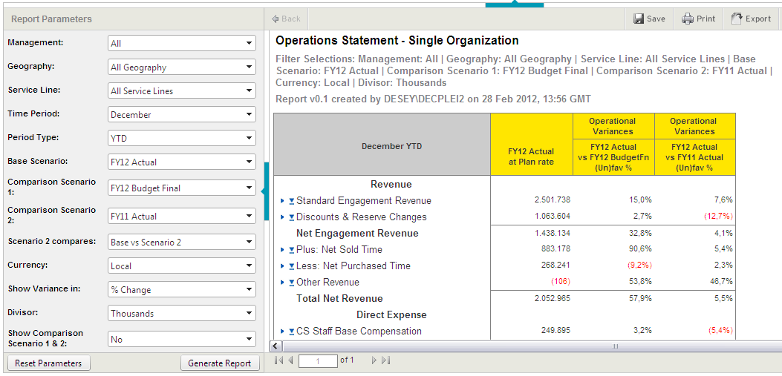
FR Standard Report Parameters Comparison scenarios (only in P&B reports)
new since release III
Users can utilize this parameter to compare peers/siblings or children members of a hierarchy within the report
Show use of base and comparison scenarios:
Base scenario parameter dictates the content of column 1
Comparison scenario 1 parameter dictates that variance against column 1 is shown in column 2
Comparison scenario 2 parameter dictates which variance is calculated in column 3
Scenario 2 parameter dictates if the base scenario or scenario 1 is used for the variance calculation in column 3

Slide 45
FR Standard Report Parameters Comparison scenarios (only in P&B reports)
new since release III
The following comparisons are available in P&B reports:
Name | Description
Base Scenario | Functions same way as Scenario filter of GFT FR Comparison Scenario 2 column Limited to FY13 Budget versions
Comparison Scenario 1 | Combination of P&B Scenario and Versions
Comparison Scenario 2 | Combination of P&B Scenario and Versions User can choose “NA” to prevent report from generating Comparison Scenario 2 column
Scenario 2 compares | Allows user to choose comparison to be shown in the 3rd columns – Base Scenario vs Comparison Scenario 2 or Comparison Scenario 1 vs Comparison Scenario 2
Show Scenario 1 & 2 Amount | Functions same way as Show Budget & PY filter of GFT FR Allows user to hide or show Comparison Scenario 1 and Comparison Scenario 2

Slide 46
FR Standard Report Parameters Comparison scenarios (only in P&B reports)
new since release III
Base Scenario | Comparison Scenario 1 | Comparison Scenario 2 | Scenario 2 compares
FY13 working | FY13 working | FY13 working | Base vs. Scenario 2
FY13 Ad Hoc 1 | FY13 Ad Hoc 1 | FY13 Ad Hoc 1 | Scenario 1 vs Scenario 2
FY13 Ad Hoc 2 | FY13 Ad Hoc 2 | FY13 Ad Hoc 2
FY13 Ad Hoc 3 | FY13 Ad Hoc 3 | FY13 Ad Hoc 3
FY13 Ad Hoc 4 | FY13 Ad Hoc 4 | FY13 Ad Hoc 4
FY13 Ad Hoc 5 | FY13 Ad Hoc 5 | FY13 Ad Hoc 5
FY13 Submission 1 | FY13 Submission 1 | FY13 Submission 1
FY13 Submission 2 | FY13 Submission 2 | FY13 Submission 2
FY13 Submission 3 | FY13 Submission 3 | FY13 Submission 3
FY13 Budget Final | FY13 Budget Final | FY13 Budget Final
 | FY12 Budget Final | FY12 Budget Final
 | FY12 MLO (8+4)* | FY12 MLO (8+4)*
 | FY12 MLO (9+3)* | FY12 MLO (9+3)*
 | FY12 MLO (10+2)* | FY12 MLO (10+2)*
 | FY12 MLO (11+1)* | FY12 MLO (11+1)*
 | FY12 Actual | FY12 Actual
 | FY11 Actual | FY11 Actual
 |  | N/A
Base Scenario drop down options are limited to FY13 Budget versions as FR should be used for Actuals reporting
* MLOs will appear in drop down option as applicable month’s
financial information becomes available for FY12
!
!

Slide 47
FR Standard Report Parameters Differences between FR & P&B reports
new since release III
FR parameters are utilized for P&B reporting with some modifications
Name | available in: |  | Description
 | FR | P&B
Show % of TNR and % of Indirects | no | yes | Functions in similar way as Show Budget & PY filter of GFT FR Allows user to hide or show %TNR and % of Indirects in column headings
OU/MU parameters | yes | no | OU and MU parameters have been removed for P&B
Variance parameters | yes | no | Variance parameters have been removed for P&B

Slide 48
Global Finance Transformation Financial Reporting Training
Reporting Tool Navigation

Slide 49
Reporting Tool Navigation Topics
1.
Accessing the Portal
2.
Standard Report Folder Structure
3.
Favorite Report Folder Structure
4.
Save Favorite Reports
5.
Layout of Financial Reports
6.
Parameter Selections
7.
Drill Down and Drill Back
8.
Exporting
9.
Printing
10.
Delegation

Slide 50
Global Finance Transformation Financial Reporting
Ad Hoc Analysis Training

Slide 51
Learning objectives
By the end of this module, you will be able to:
Describe all of the Financial Reporting dimensions used in pivot table analysis
Create a pivot table in Excel
Build custom analysis to show data in different views
Use cube formulas to create spreadsheets and conduct analysis

Slide 52
Ad hoc Analysis Features
Ad hoc users perform the following tasks:
Use Excel to connect to the database cube in the background of the Reporting application
Analyze data to answer questions which could not be answered directly by standard reports
View data for specific dimensions from the data source without writing spreadsheet functions
Perform ad hoc / free form analysis using pivot table functionality
Slice and dice data at will

Slide 53
Benefits of Pivot Tables
There are three main reasons to organize data into Pivot Tables
To summarize data from a lengthy list into a compact format
To find relationships within the data that are otherwise hard to see because of the amount of detail
To organize the data so that it is easy to chart

Slide 54
Topics
1.
Financial Reporting Dimensions Overview
2.
Differences to GFIS_FR
3.
Log In to the Ad Hoc Cube
4.
Manage Existing Connections
5.
Create Ad Hoc Analysis
6.
Ad Hoc Excel Functionality
7.
Cube Formulas for Data Retrieval

Slide 55
Financial Reporting Dimensions Overview
Dimensions for Financial Reporting
The General Ledger data is organized in ‘cubes’ with different ‘hierarchies’/ ‘dimensions’
A cube enables the user to analyze data in various views/slices with a quick execution time
These dimensions will be used as filters in reports as well as for drill-down paths
Key dimensions for Financial Reporting are:
Management dimension
Geography dimension
Service Line dimension
Markets dimension
All the above dimension are based on full or parts of the code block.
Other dimensions in FR include GL Accounts, Time Period, Period Type (like MTD/YTD), Currency and Scenario (i.e. Actual &Plan)

Slide 56
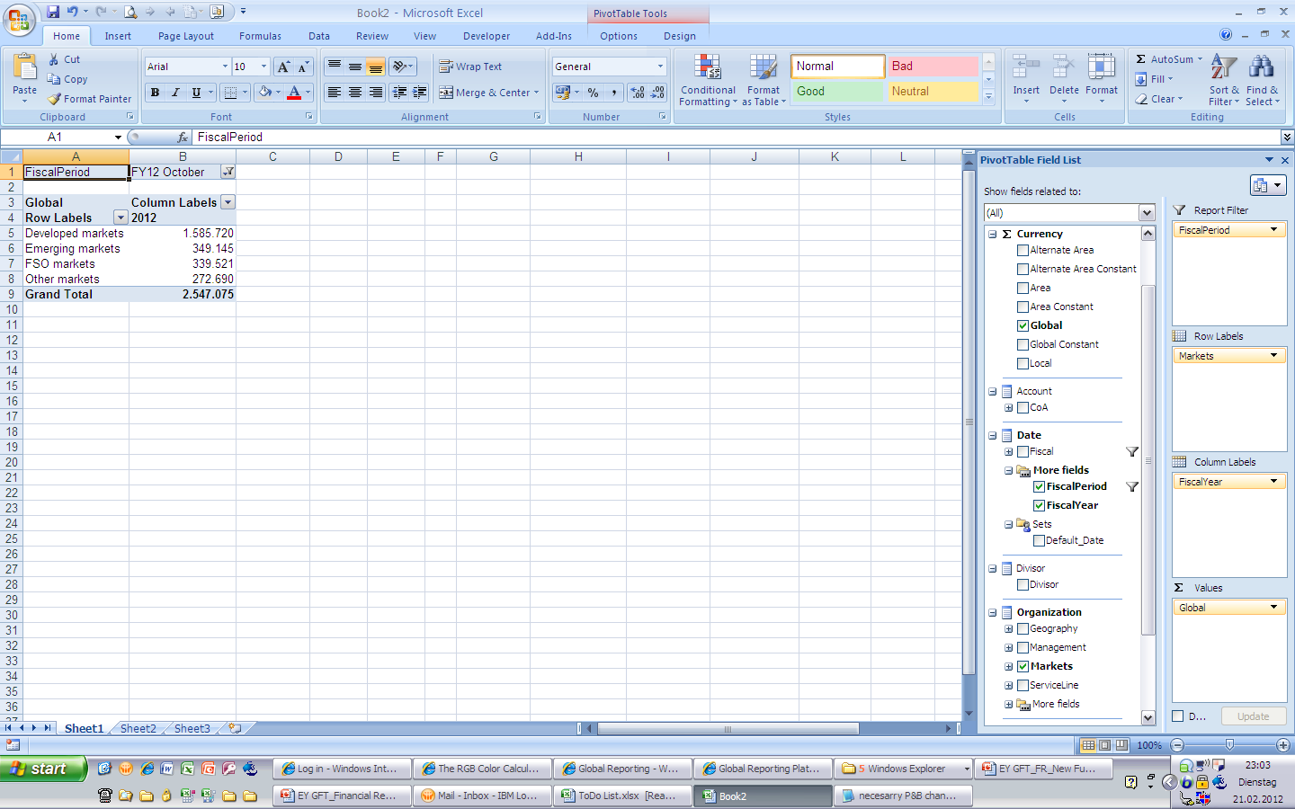
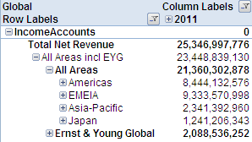
FR Dimensions - Management
Management
Maintenance:
Globally (down to Sub-Area level)
Locally by Super User (below Sub Area level)
The Management dimension captures the way EY is organized and managed internally.
As part of release 1 & 2, we will only deliver one standard management hierarchy. Additional Alternate Management hierarchies could follow as a future enhancement.
Description
Example
Globally defined allowing local flexibility
Includes double counting for ‘Private Equity Joint Venture’
Lowest level: Code block

Slide 57
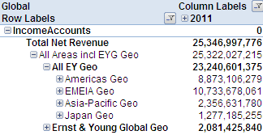
FR Dimensions - Geography
Geography
Maintenance:
Globally defined
The Geography dimension captures the legal, external structure of EY.
This structure differs from the Management dimension because Sub-Areas in the Management dimension, such as FSO and EYG Services, are accounted for within the Countries in the Geography Dimension.
Description
Example
Globally maintained Geography hierarchy
Additional roll ups can be requested via the Super Users
Lowest level: BU

Slide 58
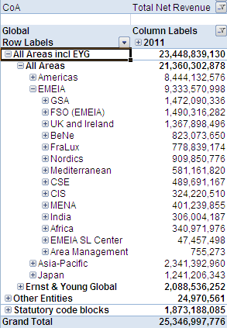
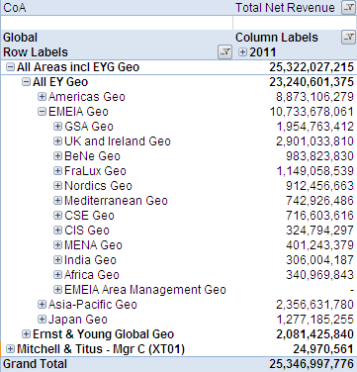
Management vs. Geography Dimension
The Management dimension represents the organizational structure across the Areas while the Geography dimension is purely geographical to provide a full country view
Management
Geography
Management Dimension:
Organizational hierarchy structure for management levels across the Areas
There are additional Sub Areas in the Management dimension which contain just parts of various countries, such as FSO, EMEIA SL Center or Area Management
Ernst & Young Global is an additional Area in the Management dimension
Geography Dimension:
Purely geographic view
Area and Sub Area elements in the Geography dimension end in ‘Geo’
The Grand Total of the Management dimension will always equal the Grand Total of the Geography dimension, however there will be differences on the Area/Sub Area level.

Slide 59
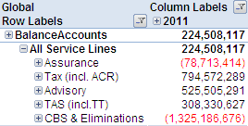
FR Dimensions - Service Line
Service Line
Maintenance:
Globally defined
Globally defined structure capturing our Service and Sub Service Lines.
No local flexibility available to reflect a different Service Line roll up.
Description
Example
Globally consistent SL hierarchy
Includes double counting for ‘Transaction Tax’ in TAS and ‘Accounting Compliance & Reporting’ (ACR) in BTC
Also includes roll ups for Tax, TAS and BTC without double counting, only available to Finance users in ad hoc
Lowest level: SMU

Slide 60
FR Dimensions - Management, Geography & Service Line
The Management, Geography & Service Line dimensions interact with each other to achieve certain cuts of the data such as Area including and excluding EYGS
Example | Management Filter Selection | Geography Filter Selection | Service Line Filter Selection
EMEIA including EYGS (Assurance) | All Areas including EYG | EMEIA Geo | Assurance
EMEIA excluding EYGS (Assurance) | EMEIA | All Geo | Assurance
FraLux excluding FSO (Advisory) | FraLux | All Geo | Advisory
FraLux incl FSO excl EYGS (Advisory) | EMEIA | FraLux Geo | Advisory
FraLux incl FSO incl EYGS (Advisory) | All Areas including EYG | FraLux Geo | Advisory
US including EYC & BBC (Tax) | US Based | Americas Geo | Tax
US excluding EYC & BBC (Tax) | US Based | US Geo | Tax
Australia + New Zealand including FSO excluding EYGS (TAS) | Asia Pacific | EYANZ Geo (parent combining Australia and New Zealand) | TAS

Slide 61
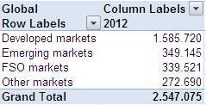
FR Dimensions - Markets
new since release III
Markets
Maintenance:
Globally defined
Globally defined structure capturing our Markets structure
No local flexibility available to reflect a different Markets assignment.
Description
Example
Globally consistent assignment of Sub-Areas to markets
Lowest level: Markets itself (e.g. developed markets); currently no hierarchy below (but can be achieved by a cross-join of the Management and Markets dimension)

Slide 62
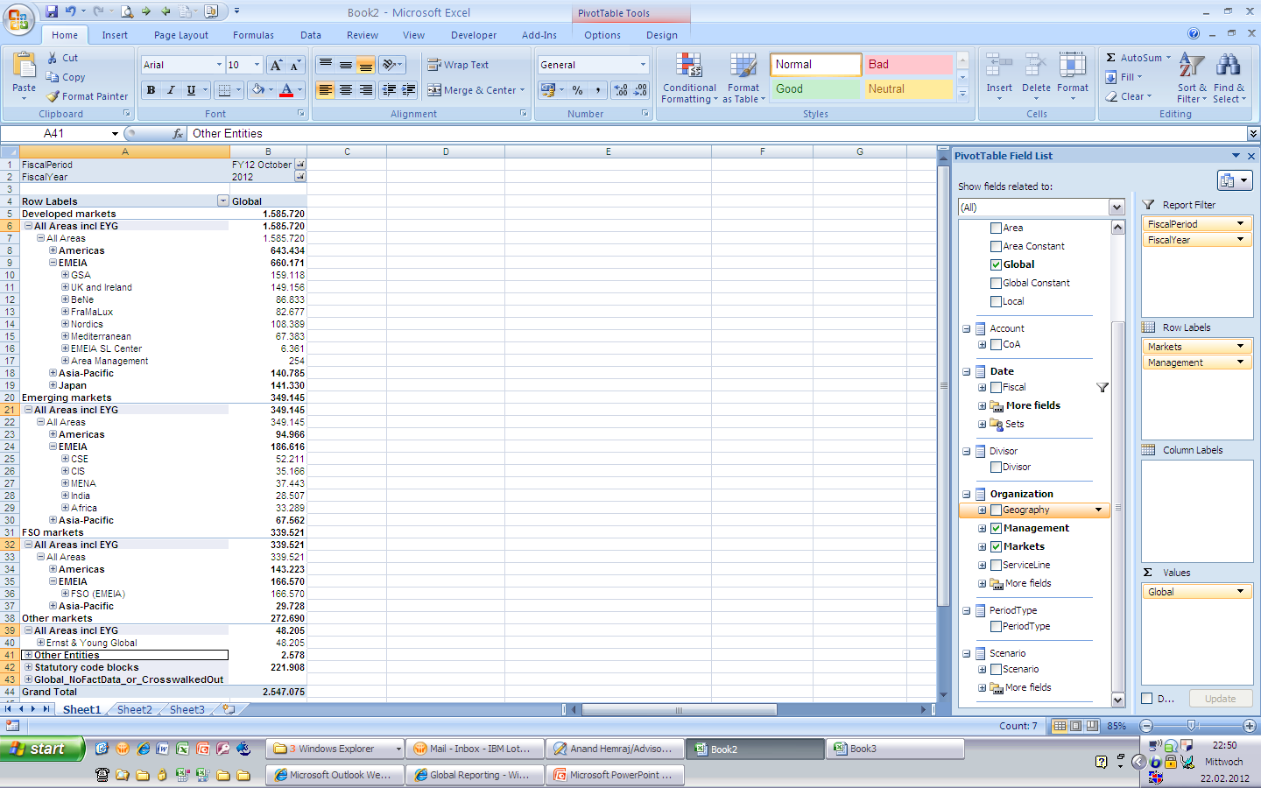
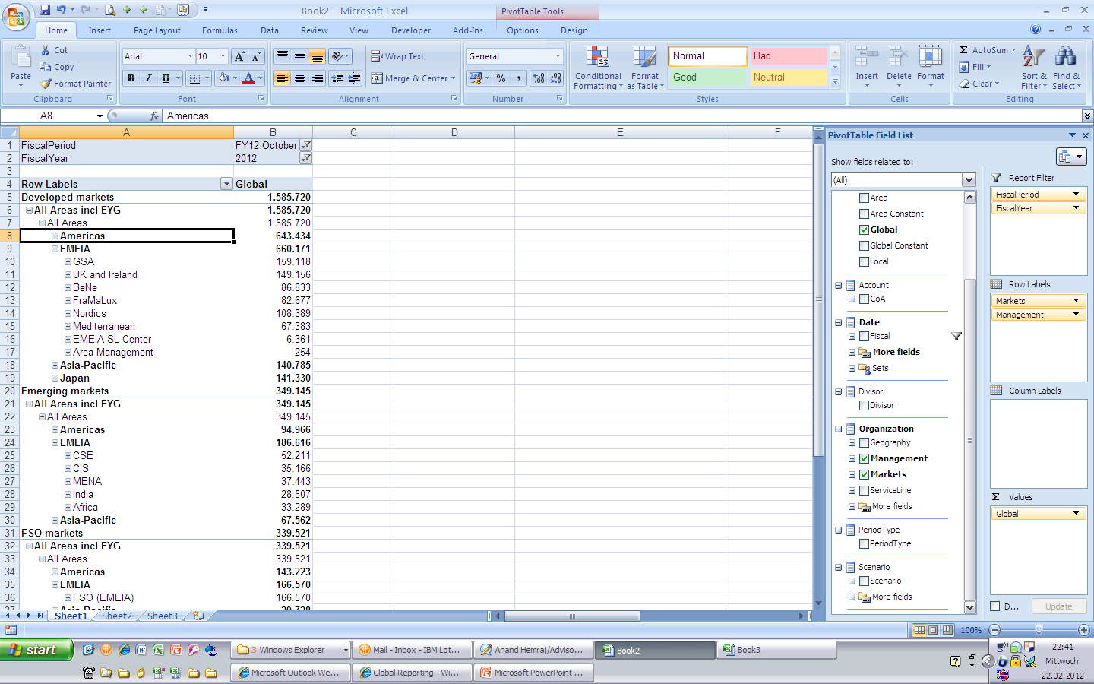
FR Dimensions - How to see which Sub-Areas assigned to which Market
new since release III
Create a cross-join of the Markets and Management dimension in columns and drill-down to the Sub-Area level (activate zero suppression)
This example shows all EMEIA Sub-Areas in the ‘Developed markets segment
This example shows all EMEIA Sub-Areas in the ‘Emerging markets’ segment

Slide 63
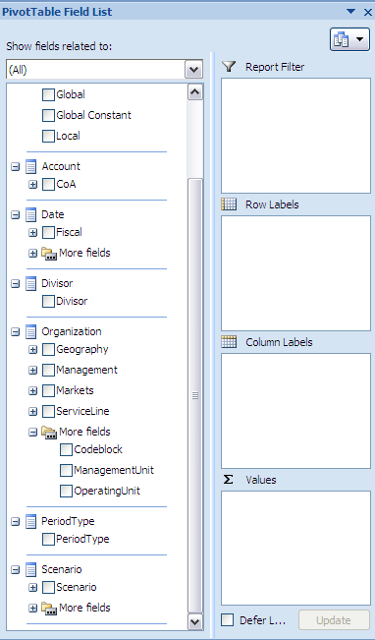
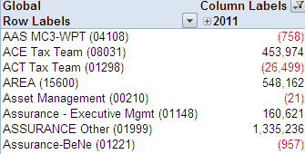
FR Dimensions - Operating Unit
Operating Unit
Maintenance:
Globally defined
This dimension will consist of a flat list of all used Operating Units and will be available to Finance only on certain reports and via ad hoc
Description
Example
Filtering plan information using this dimension might provide skewed results
Additional roll ups can be requested via the Super Users
Lowest level: OUxxx

Slide 64
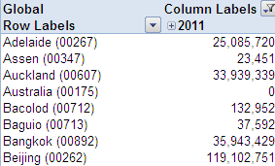
FR Dimensions - Management Unit
Management Unit
Maintenance:
Globally defined
This dimension will consist of a flat list of all used Management Units and will be available to Finance only on certain reports and via ad hoc
Description
Example
Filtering plan information using this dimension might provide skewed results
Additional roll ups can be requested via the Super Users
Lowest level: MUxxx

Slide 65
FR Dimensions - Organizational Hierarchy
new since release III
Although the code block is the lowest level in the Management Dimension, each code block element can be queried separately using the dimensions below
Management | Geography | Operating Unit* | Management Unit* | Service Line | Markets
Global Area Sub-Area .. .. Planning Unit BU-OU-MU- SMU | All Areas Area Sub-Area GFIS Country Managerial Country Legal Entity Business Unit | OUxxx | MUxxx | Service Line Sub Service Line Groups Sub Service Lines SMU Groups SMUs | All Markets Developed markets Emerging markets FSO markets Other markets
*OU and MU dimensions are available to the Finance community only

Slide 66
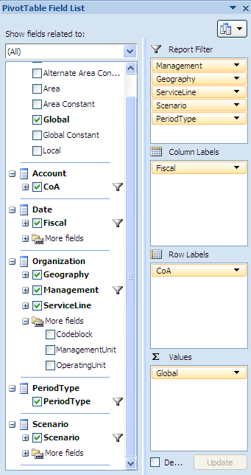
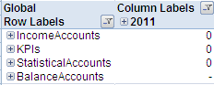
FR Dimensions - GL Accounts
GL Accounts
Maintenance:
Globally defined
Structured roll up of GL Accounts to support Operations Statement, Balance Sheet, Statistical Accounts and KPIs
Description
Example
Hierarchy of P&L, Balance Sheet and statistical accounts including additional calculated KPIs
Optimized for analysis
Lowest level: GL Account

Slide 67
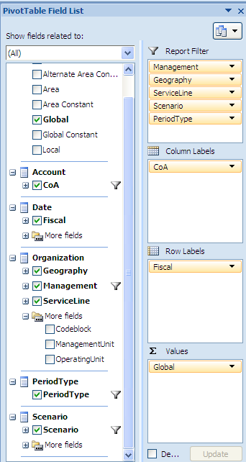
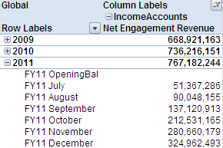
FR Dimensions - Fiscal
Fiscal
Maintenance:
Globally defined
Contains the current year and 2 years of historical data
Description
Example
Captures the fiscal year to which the data is linked

Slide 68
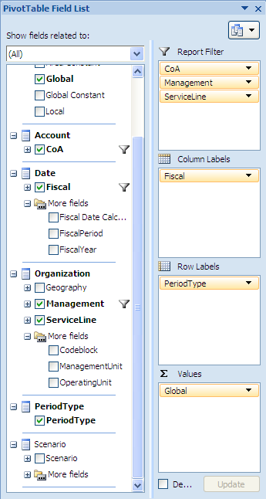
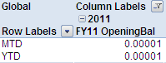
FR Dimensions - Period Type
Period Type
Maintenance:
Globally defined
Allows user to swap between MTD and YTD views
Additional period types will be added as part of a future release
Description
Example
In addition to MTD and YTD, it contains additional roll ups for Week

Slide 69
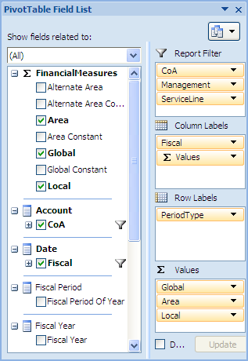
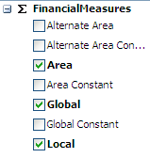
FR Dimensions - Currency*
* P&B reports only contain constant rates
Currency
Maintenance:
Globally defined
Allows the user to swap between Local, Area, Alternate Area and Global currencies
Description
Example
Allows the user to look at the data in different currencies

Slide 70
Currency Options per Area
The Global currency is US Dollar, but each Area has a different set of currencies
 | Local | Area | Alternate Area | Global
Americas | Various | USD | - | USD
EMEIA | Various | EUR | GBP | USD
Asia-Pacific | Various | AUD | - | USD
Japan | YEN | YEN | - | USD

Slide 71
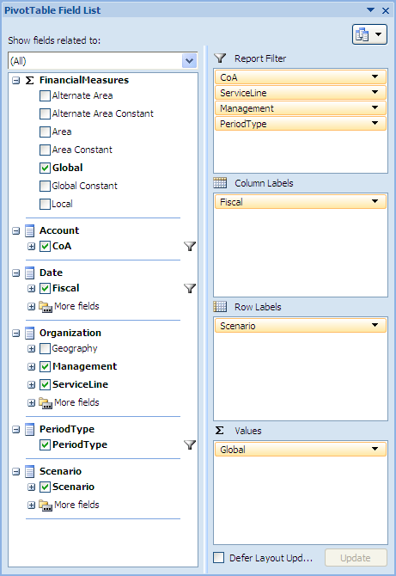
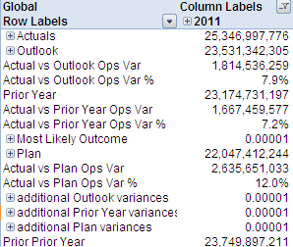
FR Dimensions - Scenario*
new since release III
* P&B ad-hoc cubes offer additional scenarios (see next page)
Scenario
Maintenance:
Globally defined
Allows the user to swap between various categories of data
Plan / Outlook data is only available in the Current Year
FY12 cube will only capture the FY12 Plan / Outlook Data
FY11 cube will only capture the FY11 Plan / Outlook Data
Description
Example
Actuals represents GFIS GL + Adjustments + Restatements
GFIS GL represents data as recorded in GFIS
Adjustments captures data for non GFIS countries and outside of GFIS adjustments
Restatements captures prior year restatements for accounting policy changes

Slide 72
FR Dimensions - Scenario P&B specific scenarios
new since release III
Comparison Scenario 1 | Description
FY13 working | Working version of FY13 Budget
FY13 Ad Hoc 1 | Ad Hoc 1 version of FY13 Budget
FY13 Ad Hoc 2 | Ad Hoc 2 version of FY13 Budget
FY13 Ad Hoc 3 | Ad Hoc 3 version of FY13 Budget
FY13 Ad Hoc 4 | Ad Hoc 4 version of FY13 Budget
FY13 Ad Hoc 5 | Ad Hoc 5 version of FY13 Budget
FY13 Submission 1 | Submission 1 version of FY13 Budget
FY13 Submission 2 | Submission 2 version of FY13 Budget
FY13 Submission 3 | Submission 3 version of FY13 Budget
FY13 Budget Final | Submission 4 version of FY13 Budget
FY12 Budget Final | Final version of FY13 Budget
FY12 MLO (8+4)* | Fixed Most Likely Outcome Scenario showing Actuals for July through February and planned numbers for March through June
FY12 MLO (9+3)* | Fixed Most Likely Outcome Scenario showing Actuals for July through March and planned numbers for April through June
FY12 MLO (10+2)* | Fixed Most Likely Outcome Scenario showing Actuals for July through April and planned numbers for May through June
FY12 MLO (11+1)* | Fixed Most Likely Outcome Scenario showing Actuals for July through May and planned numbers for June
FY12 Actual | Full year financials for FY12
FY11 Actual | Full year financials for FY11
* MLOs will appear in drop down option as applicable month’s
financial information becomes available for FY12
!

Slide 73
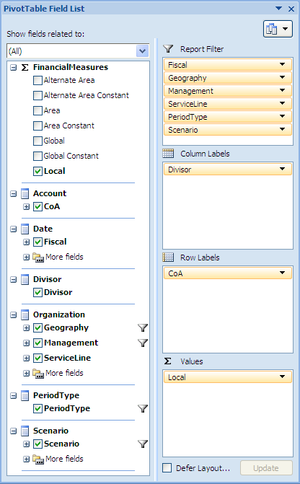
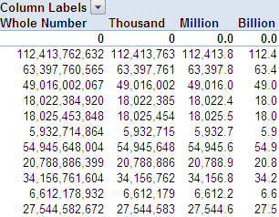
FR Dimensions - Divisor
new since release II
Scenario
Maintenance:
Globally defined
Allows the user to choose between four different possible number formats to display a value
Whole Number
Thousand
Million
Billion
Description
Example
This dimension serves to change the number display.
The underlying data is still represented as whole numbers and the Divisor only influences the displayed format

Slide 74
Topics
1.
Financial Reporting Dimensions Overview
2.
Differences to GFIS_FR
3.
Log In to the Ad Hoc Cube
4.
Manage Existing Connections
5.
Create Ad Hoc Analysis
6.
Ad Hoc Excel Functionality
7.
Cube Formulas for Data Retrieval

Slide 75
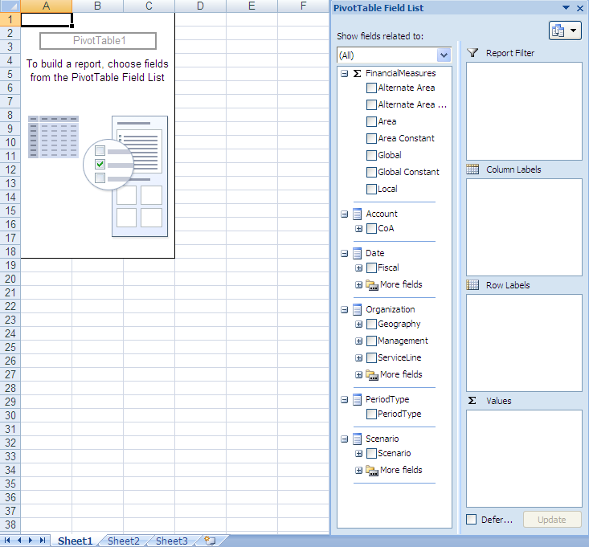
Log In to Ad Hoc Work Environment
To use ad hoc analysis functionality, the user must connect to the database using Excel 2007
Step 1: Select the ‘Data’ menu
Step 2: Create a connection to SQL Server Analysis Cube
Step 3: Connect to Database Server
Step 4: Select a Database and Cube of the connection
Step 5: Name and Save the Data Connection
Step 6: Create a Pivot Table in an Excel worksheet

Slide 76
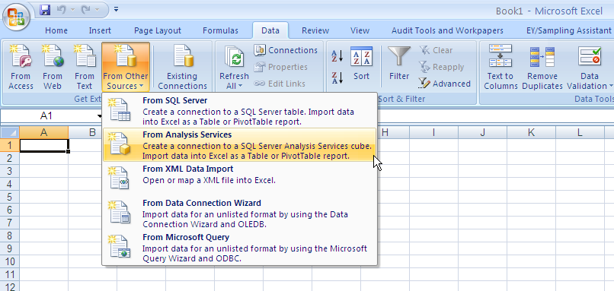
Step 1 and 2: Connect to the Cube
Create connection to SQL Server Analysis Cube
To start the process of creating a pivot table in Excel 2007, select the ‘Data’ menu in Excel and click the ‘From Other Sources’ drop down to select ‘From Analysis Services’

Slide 77
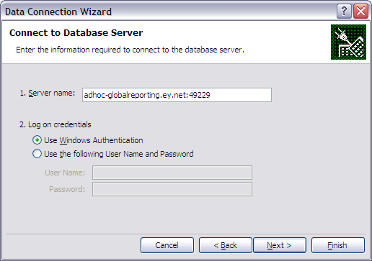
Step 3: Connect to Database Server
Use the Data Connection Wizard to Connect to the Database Server
Enter the Server Name
adhoc-globalreporting.ey.net:49229
Select ‘Use Windows Authentication’ radio button and click ‘Next’

Slide 78
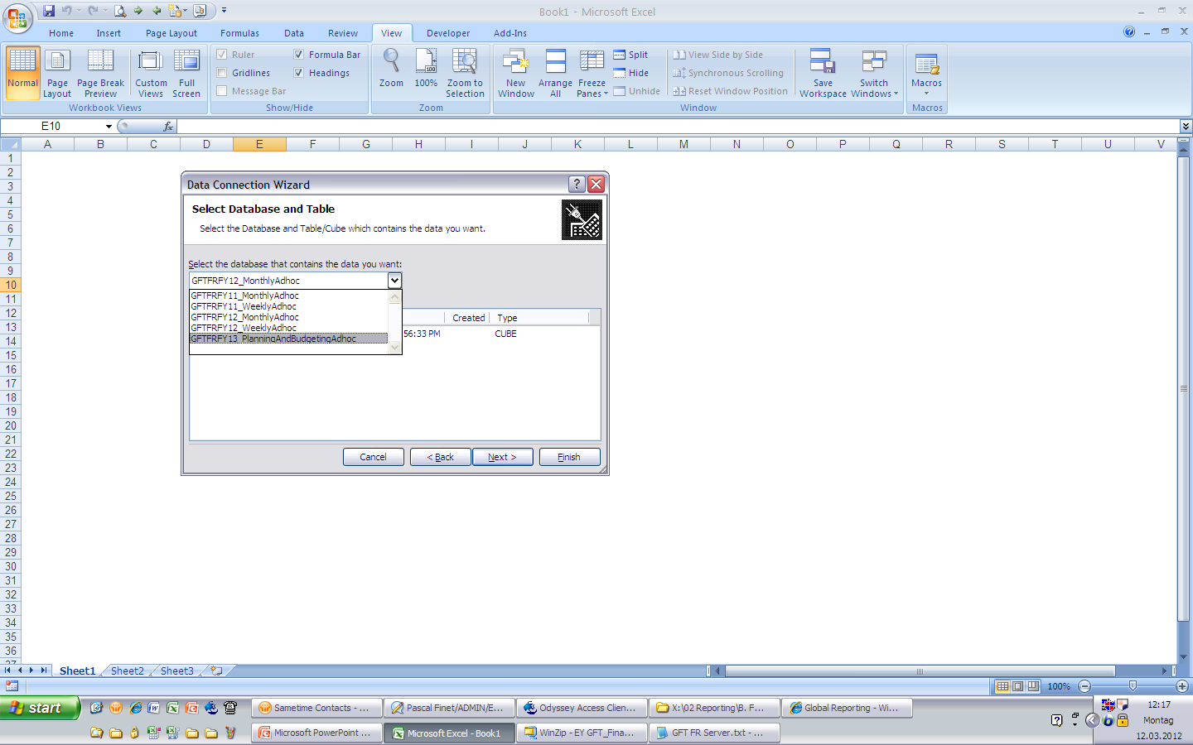

Step 4: Select Database and Table/Cube
new since release III
Select a Database and Cube of the connection
Select the database that you want to use in the drop down and click next to connect to the appropriate cube
In addition to the Monthly and Weekly cubes per FY, now a P&B-Ad-Hoc cube is available for FY13
!

Slide 79

Step 5: Save Data Connection File
Name, save, and provide a description of the data connection
Enter text in the ‘File Name’
Enter text in the ‘Friendly Name’ or ‘Description’ field
Edit and personalize the text in the ‘File Name’ field so that you can easily identify the data connection, which is saved in ‘My Documents’ > ‘My Data Sources’ folder and also in ‘Existing Connections’
Edit and personalize the text in the ‘Friendly Name’ field so that you can easily identify the data connection, which is stored in excel in ‘Existing Connections’
It is best practice to use a standard ‘Friendly Name’ within a Sub-Area to be consistent when converting to formulas.
!
‘File Name’ and ‘Friendly Name’ Name Recommendations:
Use a combination of FY and cube type, Format: [FY]_[Type] e.g.:
FY11 cubes
Monthly: FY11_M
Weekly: FY11_W
FY12 cubes
Monthly: FY12_M
Weekly: FY12_W

Slide 80

Step 6: Import Data into Pivot Table Format
Create a pivot table in an Excel worksheet
Select ‘PivotTable Report’ and choose a cell within your excel worksheet to place the pivot table and select ‘OK’

Slide 81
Topics
1.
Financial Reporting Dimensions Overview
2.
Differences to GFIS_FR
3.
Log In to the Ad Hoc Cube
4.
Manage Existing Connections
5.
Create Ad Hoc Analysis
6.
Ad Hoc Excel Functionality
7.
Cube Formulas for Data Retrieval

Slide 82
Managing Existing Connections
A
Access Existing Connections
B
Edit New or Existing Connections
C
Change Cube Formula Connections
D
Delete Existing Cube Connections

Slide 83


A. Existing Connections
Once the user establishes an initial cube connection, the user can connect to the cube using the ‘Existing Connections’ icon in the ‘Data’ tab in the future

Slide 84


A. Excel Connections to Cubes and Common Friendly Connection Name
Please remember
The connection string is always saved in the Excel file (so you can send it to other people without changing/adding a new connection
But please keep in mind that the user access restrictions are applied to the connection, so the data, filters and dimensions could look different
email
user A
user B
Recommendation
Use a combination of FY and cube type, Format: [FY]_[Type] e.g.:
FY11 cubes
Monthly: FY11_M
Weekly: FY11_W
FY12 cubes
Monthly: FY12_M
Weekly: FY12_W

Slide 85


B. Change the Ad hoc cube connection to another cube (1/5)
Open the connection
I. Click on connections in the Data tab of MS Excel
II. Mark the connection you want to edit and click on “Properties”

Slide 86


B. Change the Ad hoc cube connection to another cube (2/5)
Edit the connection (if it is a new connection – not an existing connection)
III. Click on the Definition tab
IV. Change friendly connection name, description, Server name (and Cube name if necessary)
current friendly name
new friendly name
current description
new description
current server name
new server name
current cube name
(same) cube name

Slide 87

B. Change the Ad hoc cube connection to another cube (3/5)
Verify connection change and update data (if it is a new connection – not an existing connection)
V. Click “Ok”, verify the prompt with “Yes” and the cube query will be updated
Please be aware
Doing that you will not replace the connection saved under “My Documents > My Data Sources”
It won’t add it to your friendly connections in Excel
By changing the cube name you can also change from a Monthly to a Weekly week cube or a FY11 to FY12 cube (or vice versa)
Depending on the type of query the report might not work anymore because of structural changes in dimensions (sp please be careful with that and keep a copy)

Slide 88

B. Change the Ad hoc cube connection to another cube (4/5)
Edit the connection (if you want to use an existing connection)
III. Click on the Definition tab and click on Browse
IV. Select the connection file and click on “Open”
current friendly name
current description
current server name
current cube name

Slide 89
B. Change the Ad hoc cube connection to another cube (5/5)
Verify connection change and update data (if you want to use an existing connection)
V. The connection string is updated and you need to change the connection name and description
VI. Click “Ok” and the cube query will be updated
new friendly name
new description
Connection string was update from the file selected
Please be aware
Selecting the connection file does not replace the friendly name
By changing the cube name you can also change from a Monthly to a Weekly week cube or a FY11 to FY12 cube (or vice versa)
Depending on the type of query the report might not work anymore because of structural changes in dimensions (sp please be careful with that and keep a copy)

Slide 90


C. Change Ad hoc cube connection based on a pure Cube-Formula-based report (1/2)
I. Add the new cube connection (as you normally set up access to any cube) or choose an existing one
II. Look up if the connection is available in the Excel file
Both connections are existing in the file now
As the last step of the connection process you need to select “Only Create Connection” (instead of PivotTable Report). This will only add the connection (to “Connections” in the “Data” tab in Excel)

Slide 91


C. Change Ad hoc cube connection based on a pure Cube-Formula-based report (2/2)
III. Use the “Search and Replace” functionality of Excel to replace the old friendly name (pointing to UAT) with the new friendly name (pointing to Production)

Slide 92



D. Delete Existing Ad hoc Cube Connections (1/3)
1) Where is the connection saved
Based on your settings when creating the connection
The connection is saved under My Documents > My Data Sources …
… and shown under “Existing Connections” in MS Excel

Slide 93

D. Delete Existing Ad hoc Cube Connections (2/3)
2a) Delete connections in Excel
Do the following steps
Open “Existing Connections” in MS Excel
Select the file/connection you want to delete
Delete it (right click > Delete) or press the Delete button and verify with “Yes”
Click Cancel
It will disappear in your “Existing Connections” in MS Excel after you closed the “Existing Connections” prompt and opened it again

Slide 94

D. Delete Existing Ad hoc Cube Connections (3/3)
2b) Delete connections in Explorer
Do the following steps
Open “My Data Sources” within your “My Documents” folder
Select the file/connection you want to delete
Delete it (right click > Delete) or press the Delete button and verify with “Yes”
It will disappear in your “Existing Connections” in MS Excel afterwards

Slide 95
Topics
1.
Financial Reporting Dimensions Overview
2.
Differences to GFIS_FR
3.
Log In to the Ad Hoc Cube
4.
Manage Existing Connections
5.
Create Ad Hoc Analysis
6.
Ad Hoc Excel Functionality
7.
Cube Formulas for Data Retrieval

Slide 96

Layout of Ad Hoc Analysis Work Environment
Users can build a pivot table by using the ‘PivotTable Field List’ panel
PivotTable Ribbon/Toolbar
Select the dimensions that you want to incorporate within your table to build a report.
One or multiple elements can be selected within each dimension
The dimensions selected in this section will dictate the data that is displayed within the table
The dimensions/ ’fields’ selected in the ‘PivotTable Field List’ will be automatically placed in one of these four quadrants.
Only dimensions with a summation sign will be placed in the ‘Values’ quadrant
The user can drag and drop selections between ‘Report Filter’, ‘Row Labels’, and ‘Column Labels’ to customize the table
PivotTable Workspace
PivotTable Field List

Slide 97




PivotTable Field List
Users can alter the layout of the PivotTable Field List based on personal preferences

Slide 98

PivotTable Field List Quadrants
The placement of the dimensions within the quadrants will influence the layout of the pivot table
Report Filters
Allows user to focus on specific sections of data
Multiple dimensions can be displayed simultaneously as report filters
Column Labels
Date and time hierarchies are automatically added to the Column Labels quadrant
Use Column Labels to display fields as columns at the top of the report
Columns lower in position in the Column Labels quadrant are nested within another column immediately above it
Row Labels
Non-numeric dimensions/fields are automatically added to Row Labels
Use Row Labels to display fields as rows on the side of the report
Rows lower in position in the Row Labels quadrant are nested within another row immediately above it
Values
The Values quadrant is used specifically to display numeric data

Slide 99

Build an Ad hoc analysis in Excel
To build and design ad hoc analysis, users can format and customize reports by selecting dimensions
Step 1: Select a dimension as a Value
Step 2: Select dimension(s) for Row Labels
Step 3: Select dimension(s) for Column Labels
Step 4: Select dimension(s) for Report Filters

Slide 100



Step 1: Select Dimension as a Value
Values are used to display numeric data so the Currency dimension will always default to the Values quadrant
Select field/dimension from the ‘PivotTable Field List’ to add to the ‘Values’ field
All fields with summation signs indicate the field to be a ‘Value’ or measure
In this instance, choose one or more currencies for the ‘Value’

Slide 101



Step 2: Select Dimension(s) for Row Labels
Select the ‘Account’ dimension as a Row Label
Select ‘Account’ field/dimension from the ‘PivotTable Field List’ to add to the ‘Row Labels’

Slide 102



Step 3: Select Dimension for Column Labels
Select ‘Fiscal’ in the ‘Date’ dimension and place it in Column Labels
Select ‘Fiscal’ field/dimension from the ‘PivotTable Field List’ to add to the ‘Column Labels’

Slide 103



Step 4: Select Dimension for Report Filters
Select ‘Geography’, ‘Management’ and ‘ServiceLine’ in the ‘Organization’ dimension, the ‘PeriodType’ dimension, and the ‘Scenario’ dimension to place in Report Filter

Slide 104



Visual Totals
Visual totals refer to totals displayed when one or more members in a hierarchy are filtered within the pivot table. All totals will reflect the aggregation of only the members present and visible in the pivot table at that time.
Americas with US based
Americas without US based
Remove ‘US based’ hierarchy member:
Select the cell containing the hierarchy member labeled ‘US based’
Click the filter icon and deselect the ‘US based’ member label
Click ‘OK’
Notice the ‘Americas’ total and all totals above ‘Americas’ are different in the two screenshots
In one example ‘US based’ is included in the aggregated total and in the other example ‘US based’ is not included in the total because it has been removed.
When ‘US based’ is removed, all totals above will change to exclude ‘US Based’ in the totals.

Slide 105




Error message in MS Excel using Ad hoc cubes
During the daily data updates the following two messages may occur. “Refresh All” will resolve this.
a)
b)
Solution

Slide 106
Topics
1.
Financial Reporting Dimensions Overview
2.
Differences to GFIS_FR
3.
Log In to the Ad Hoc Cube
4.
Manage Existing Connections
5.
Create Ad Hoc Analysis
6.
Ad Hoc Excel Functionality
7.
Cube Formulas for Data Retrieval

Slide 107
Additional Ad hoc Excel Functionality
A
Expand/Collapse Rows & Columns
B
More Fields Folder
C
Disable Zero Suppression
D
Drag and Drop Dimensions
E
Choose Multiple Items in Report Filters
F
Select Single Elements for Rows & Columns
G
Filter Rows or Columns with Multiple Dimensions
H
Add/Remove Totals & Sub-Totals to Pivot Tables
I
Show Hover Effect
J
Calculated Members

Slide 108

A. Expand/Collapse Rows & Columns
Users can expand and collapse rows and columns in the pivot table to see additional levels of detail. This serves the same purpose as drill down.
Click the expand or collapse icons in the row or column to see additional levels of detail
Press ‘+’ button in front of a row to ungroup and expand this section
A pre-defined number of rows appears
This functionality is similar to drill-down on the standard reports
Press ‘-’ button in front of a column to group and collapse this section
This functionality is similar to a drill-back on the standard reports

Slide 109



A. Expand Entire Field on Rows & Columns
Users can expand all rows or columns on the same hierarchy level in a pivot table by using the ‘Expand Entire Field’ icon on the PivotTable toolbar
1
Collapsed
2
Expanded
The user can select a member in a row or column with an expand box ‘+’ next to it and click ‘Expand Entire Field’ to expand every other member on the same hierarchy level
Only row or column members on the same hierarchy level as the selected cell showing a ‘+’ next to it can be expanded
The benefit is that the user can expand multiple fields at once
Screen shot 1:
‘Total Assets’ member cell is selected and is collapsed across rows
‘Total Assets’ and ‘Total Liability and Equity’ are on the same hierarchy member level and are all collapsed with a ‘+’ next to them
Screen shot 2:
Once the user selects ‘Expand Entire Field’, then ‘Total Assets’ will expand and show all members one level directly below
All other members on the same hierarchy level as ‘Total Assets’ will also be expanded and show members one level directly below

Slide 110


A. Collapse Entire Field on Rows & Columns
Users can collapse all rows or columns on the same hierarchy level in a pivot table by using the ‘Collapse Entire Field’ icon on the PivotTable toolbar
1
Expanded
2
Collapsed
The user can select a member in a row or column with a collapse box ‘-’ next to it and click ‘Collapse Entire Field’ to collapse every other member on the same hierarchy level
Only row or column members on the same hierarchy level as the selected cell showing a ‘-’ next to it can be collapsed
The benefit is that the user can collapse multiple fields at once
Screen shot 1:
‘2009’ member cell is selected and is expanded across columns
The next lowest level of detail (fiscal months) is displayed in the row immediately below ‘2009’
Screen shot 2:
Once the user selects ‘Collapse Entire Field’, then ‘2009’ will collapse and show only members on its hierarchy level (ex. 2010)
Notice that the row showing the lower level of detail in screen shot 1 has been collapsed in screen shot 2

Slide 111

B. More Fields Folder
Attribute hierarchies are put into a ‘More Fields’ folder under the dimension folder to which the hierarchies belong
Date Dimension:
The user can choose Fiscal, which will allow the user to show both FiscalPeriod and FiscalYear in the same analysis by using the expand and collapse functionality.
If the user only wants to select either FiscalPeriod or FiscalYear then the user can expand More Fields and choose only one of these attributes/elements.
Note: Dimensions and hierarchies related to Time are always automatically placed in columns because it is common to display time information across the top of a report.
Organization dimension:
The user can choose between a combination of the Geography, Management, and ServivceLine dimensions to display in the ad hoc analysis.
The user can expand the More Fields folder and see a much lower level of detail by selecting code block or individual elements of the code block.
Scenario dimension:
The user can choose between multiple Scenarios in the ad hoc analysis, including Actuals, Outlook, Most Likely Outcome, and Plan
The user can expand the More Fields folder and see a much lower level of detail

Slide 112



C. Disable Zero Suppression
Users have the option to show rows and columns if no values are contained within the pivot table
1
2
3
Right click on the pivot table and select ‘PivotTable Options’ in the drop down menu
PivotTable Options:
In the ‘Display’ tab, check both tick boxes labelled ‘Show items with no data on rows’ and ‘Show items with no data on columns’
Row and column headers will appear even when there are no cell values

Slide 113






D. Drag and Drop Dimensions
Users can drag and drop dimensions between Row Labels, Column Labels, and Report filters to view data from different perspectives
View 1
View 2
View 3
The blue line indicates the order of the dimensions within the table, which determines how the data is sliced
Notice that the layout of the Excel table is different when the ‘Row Labels’ order is switched

Slide 114



E. Choose Multiple Items in Report Filters
Users can add multiple elements in a dimension to the table by using the Report Filters
Table with Single Data Element
Table with Multiple Data Elements
Select Elements from PivotTable Field List
In this table, only one data element is selected
The numbers in the table will reflect ‘GSA’ data only
In this table, multiple data elements are selected
The user must check the ‘Select Multiple Items’ box to aggregate data
The numbers in the table will reflect ‘GSA’, ‘UK&I’, and ‘BeNe’ data aggregated together
The user can also choose which elements to incorporate within the table by selecting the filter icon within the ‘PivotTable Field List’
The dimension must be in the ‘Report Filter’ quadrant to use this functionality
Choosing multiple items in the filters may significantly impact performance.
!

Slide 115


F. Select Single Elements for Rows & Columns
Users can select a single element or a combination of elements in the Rows and Columns within the table, as well as in the Report Filter
All elements in the rows are selected in the drop down and displayed in the pivot table
The user can uncheck boxes in the drop down to show a specific set of elements in the rows of the pivot table

Slide 116





G. Filter Rows or Columns with Multiple Dimensions
When there are multiple dimensions in a row or column then the user must select the cell of the dimension that the user wants to filter
The user can also switch between dimensions in the column label drop down

Slide 117


H. Add Totals
The user can select ‘PivotTable Options’ and in the ‘Totals & Filters’ tab the user can select ‘Show grand totals for rows’ and ‘Show grand totals for columns’

Slide 118


H. Add/Remove Sub-Totals
By default, the pivot tables will display sub-totals shaded in grey in the far right column of the table
Users can remove sub-totals by clicking on the ‘Design’ tab under ‘PivotTable Tools’ and then clicking the ‘Subtotals’ drop down menu and selecting ‘Do Not Show Subtotals’

Slide 119


I. Show Hover Effect
Users can hover over any cell in the pivot table to see the detail and property information behind a cell value or line item
The user can control which details and properties are displayed when hovering by using the PivotTable Options and selecting ‘Show Properties in Tooltips’ and ‘Show Contextual Tooltips’
Hover mouse over a field to see the additional detail around the Term / KPI / Metric (e.g. TER).
Example: When the user hovers over the line item ‘Japan’, the user will see:
Parent hierarchy (All Areas)
The order in which Japan appears in its hierarchy
Drill Down path
TIP:
It is recommended to deselect both tooltips
Selecting only “Show Contextual Tooltips’ will provide the user with information regarding the Value, Row and Column
Selecting only “Show Properties in Tooltips’ will provide the user with information only regarding a line item’s position in a hierarchy
Selecting neither will disable the hover effect

Slide 120



J. Calculated Members
Users can display values for Developed Markets, Emerging Markets, and FSO Markets in the ad hoc cube by selecting ‘Show calculated members from OLAP server’.
These calculated members are currently only in the ad hoc cubes. Eventually they will be in the portal as well.
!

Slide 121
Topics
1.
Financial Reporting Dimensions Overview
2.
Differences to GFIS_FR
3.
Log In to the Ad Hoc Cube
4.
Manage Existing Connections
5.
Create Ad Hoc Analysis
6.
Ad Hoc Excel Functionality
7.
Cube Formulas for Data Retrieval

Slide 122
Converting Pivot Tables to Formulas
Converting a pivot table to formulas allows the user to access and refresh the same data that exists in the cube
Benefits
Converts a pivot table to worksheet formulas in order to utilize all Excel functionality
Provides additional flexibility to customize table layouts to conduct analysis (e.g. add columns/rows)
Simplifies process of creating, updating, and maintaining regular analysis
Data in pivot tables converted to formulas can be refreshed
The user can reference multiple cubes on the same excel worksheet
Negatives
Removes ability to expand/collapse rows and columns (drill down)
Can continue to refresh data, but only manually add/update elements in rows or columns

Slide 123


Convert Data to Formulas
To build and design ad hoc reports, users can format and customize reports by selecting dimensions
Step 1: Create pivot table resembling desired layout
Step 2: Copy pivot table to new tab within Excel worksheet*
Step 3: Select PivotTable Tools
Step 4: Convert pivot table to OLAP formulas
Step 5: Determine method to convert filters
Convert entire PivotTable and Report Filters
Convert PivotTable excluding Report Filters
If a user wants to send a worksheet with cube formulas to someone that does not have access to the cube then the user must copy the worksheet and paste values to a separate excel worksheet.
!
*This is a recommended best practice, but is not a mandatory step in the process.

Slide 124


Step 1: Create Pivot Table Resembling Desired Layout
Create pivot table that most closely reflects the desired final layout with appropriate filtering, sorting, and expanding/collapsing
It is best practice to only have one dimension in the columns and any additional dimensions in filters. This will allow column headings to be easily referenced in the cube formulas.
It is important to avoid overcomplicating column headings.
‘Select All’ needs to be checked in the Row Labels drop down in order to convert to cube formulas.
!

Slide 125



Step 2: Copy Pivot Table to New Tab
Copy pivot table tab onto another tab within the worksheet so that you can always refer to the original pivot table before converting to formulas
Select ‘Create a copy’ to copy the pivot table worksheet and select its placement within the Excel workbook. Click ‘OK’ to initiate the copy.
The tab containing the pivot table has been replicated within the Excel workbook and will allow the user to refer back to the original pivot table once the pivot table is converted to formulas.
Right click on the worksheet tab in which the pivot table is located and then select ‘Move or Copy’.

Slide 126
Step 3: Gain Access to PivotTable Tools
Select a cell within the pivot table to access the PivotTable toolbar
After preparing a pivot table with the desired look and feel, select a cell within the pivot table to activate the ‘PivotTable Tools’

Slide 127


Step 4: Convert PivotTable to OLAP Formulas
Select the ‘Options’ tab within the ‘PivotTable Tools’ and in the ‘OLAP tools’ drop down select ‘Convert to Formulas’

Slide 128



Step 5: Convert Report Filters
The user has the option to incorporate Report Filters into the Excel worksheet before formulas are converted
If the ‘Convert Report Filters’ check box is unchecked then the pivot table will be converted to formulas excluding Report Filters
If the ‘Convert Report Filters’ check box is checked then the pivot table will be converted to formulas including Report Filters

Slide 129
Situations to Convert Pivot Tables to Formulas
There are multiple situations in which it is advantageous to convert pivot table to formulas
It is appropriate to convert pivot table to formulas when the user wants to:
A
Rearrange and delete rows, columns or cells
B
Insert rows and columns
C
Add a Total row and column
D
Format rows and columns
E
Use absolute cell references

Slide 130


A. Rearrange and Delete Cells
Customize analysis by moving, arranging, and deleting cells and format the cells and worksheet to satisfy user preferences
The user can highlight rows or columns and delete the selected fields in order to rearrange the layout of the worksheet.
The ‘2011 Total’ column still re-flects the original sum and did not refresh
!

Slide 131



B. Insert Rows and Columns
Insert rows or columns to format a spreadsheet, to make additional calculations, to add formulas, or to provide supporting commentary or text
To insert a column, the user must right click the top of the column that the new column will precede and then select ‘Insert’.
The user can insert text and formulas into the new column. In this instance, total values for Quarter 1 were input and calculated into the new column.

Slide 132





C. Add a Total Column or Row
The user can manually add columns or rows to the worksheet in order to calculate Total columns or rows within the analysis
To calculate the column or row total, enter the formula ‘=sum()’ with all of the values that make up the sum in between the parentheses.
1
2
3
Select the cell with the calculated total/sum and left click the bottom right corner of the cell. A drag box ‘+’ will appear when the bottom right corner is selected . Once the drag box appears, drag the formula across the other cells that require the sum formula and the cells will populate with total values.

Slide 133


D. Format a Total Column or Row
The user can highlight entire rows or columns or select individual cells and then right click to format the cell values
To format the cell values, right click on an individual cell or a group of highlighted cells and select ‘Format Cells..’ On the ‘Number’ tab, the user can customize how values are displayed within the cell. If the user selects ‘Number’ in the ‘Category:’ section then the user can use commas to separate thousands and can also indicate a negative number by displaying it in red font enclosed in parentheses.

Slide 134

E. Use Cell References
The user can alter cell values by using cell references to calculate different results
‘Monthly Ad Hoc FR’ is the friendly name that the user assigned to cube. It is helpful if the friendly name is consistent within Sub-Areas. ‘$B$1’ references the ‘Management’ dimension ‘$B$2’ references the ‘Scenario’ dimension | ‘$B$3’ references the ‘PeriodType’ dimension ‘$A$5’ references the ‘Currency’ dimension ‘$A11’ references the ‘Chart of Accounts’ dimension ‘B$7’ references the ‘Time’ dimension
TIP: The user can select a cell and press ‘F2’ to see which cells/values are being referenced.

Slide 135
E. Absolute Cell References
Place a dollar sign ‘$’ before the column letter and/or row number in the formula to lock a column and/or row reference into the formula.
 | C | D | Comment
4 | = A1+B2+C3 | = B1+C2+D3 | Letters change when you copy a formula into a different column.
5 | = A2+B3+C4 | = B2+C3+D4 | Numbers change when you copy a formula into a different row.
Description | Example
When the dollar sign precedes the column letter then the column letter stays unchanged when the formula is copied. | =$A1
When the dollar sign precedes the row number then the row number stays unchanged when the formula is copied. | =A$1
When the dollar sign precedes both the column letter and the row number then both the column letter and the row number are unchanged if the formula is copied. | =$A$1
If you want to create a set of formulas that will always refer to either one specific row: A$1, or one specific column: $B2, use a dollar sign in front of the letter or row number. This is called an absolute cell reference. The letter or number following the dollar sign will remain unchanged if the formula is copied. Dollar signs do not change the format of the cell or the value of the formula.
TIP
After entering a formula or highlighting a specific cell reference, the user can press the F4 key to toggle between relative (references that adjust and change when copied) and absolute cell references.

